Slide 1
Public Affairs Specialist

Slide 2
Agenda
About Us
SBA Office of Disaster Assistance (ODA)
1
……………………………………………………………………......
Available Programs & Services
( Remnants of Hurricane IDA)
2
3
How to Apply | Get Help
4
Q&A

Slide 3
About Us
U.S. Small Business Administration (SBA)
Office of Disaster Assistance (ODA)
Mission Statement
To provide low interest disaster loans to businesses of all sizes, private nonprofit organizations, homeowners and renters to repair or replace real estate, personal property, machinery & equipment, inventory and business assets that have been damaged or destroyed in a declared disaster.
3

Slide 4
About Us
RESOURCE PARTNERS
SBA Regional & District Offices, Small Business Development Centers, Women Busines Centers & SCORE
Help reconstruct financial records, prepare financial statements and complete SBA Disaster Loan applications at no cost.
Provide follow-up assistance to businesses whose disaster loan applications are either approved, declined or withdrawn.
Provide management and counseling services to disaster business loan applicants (Long Term Recovery Process).
4
SBA.gov/Disaster | 1-800-659-2955 | (TTY) 1-800-877-8339

Slide 5
Program Information
Presidential Declaration; FEMA Grants and SBA Disaster Loans.
PRIMARY COUNTIES: Bronx, Kings, Nassau, Queens, Richmond, Rockland, Suffolk, and Westchester in New York, which are eligible for both Physical Property Damage & Economic Injury Disaster Loans from the SBA.
ADJACENT COUNTIES: Small businesses and most private nonprofit organizations in the following adjacent counties are eligible to apply only for Economic Injury Disaster Loans (Working Capital): New York, Orange, and Putnam in New York; Fairfield in Connecticut; and Bergen and Passaic in New Jersey.
Filing Deadlines:
Physical Property Damage Applications: November 4, 2021
Economic Injury (Working Capital): June 6, 2022
5
SBA.gov/Disaster | 1-800-659-2955 | (TTY) 1-800-877-8339

Slide 6
Program Information
Interest Rates
Physical Property Damage As Low As
Homeowners & Renters 1.563%
Businesses of all sizes 2.855%
Non-Profit Organizations 2.000%
Economic Injury Disaster Loans
Small Businesses & Small Agricultural
Cooperatives 2.855%
Non-Profit Organizations 2.000%
Filing Deadlines:
Physical Property Damage Applications: November 4, 2021
Economic Injury (Working Capital): June 6, 2022
6
SBA.gov/Disaster | 1-800-659-2955 | (TTY) 1-800-877-8339

Slide 7
Program Information
Types of Loans | Borrowers | Purpose | Max Amount
Physical Damage (Businesses) | Businesses and private nonprofits | Repair/replace real estate, equipment, furniture, etc. | $2 million *
Economic Injury (EIDL) | Small businesses & private nonprofits | Economic injury disaster loans or working capital loans | $2 million *
Physical Damage (Homes) | Homeowners | Repair or replace real property | $200,000
Physical Damage (Contents) | Homeowners & Renters | Repair or replace personal property | $40,000
Mitigation Funding | Businesses, private nonprofits and homeowners | Protect the property against future damage from similar disasters | Up to 20% of verified physical damage. Homeowners limited to $200,000.
* Unless the business qualifies as a Major Source of Employment (MSE).
7
SBA.gov/Disaster | 1-800-659-2955 | (TTY) 1-800-877-8339

Slide 8
Program Information Eligibility, Credit & Repayment
Eligibility:
Applicants must be in a declared county.
Credit History
Applicants must have a credit history
acceptable to SBA.
Repayment Applicants must show the ability to repay the loan.
Only uninsured or otherwise uncompensated Disaster related losses are deemed eligible by this declaration.
Secondary homes or vacation properties, personal pleasure boats, airplanes, recreational vehicles and similar property are not eligible, unless used for business purposes (e.g. qualified rental properties).
Applicants who have not complied with the terms of previous SBA loan agreements may not be eligible. This includes borrowers who did not maintain flood and/or hazard insurance.
8
SBA.gov/Disaster | 1-800-659-2955 | (TTY) 1-800-877-8339

Slide 9
Program Information Collateral & Insurance
Physical loans under $25,000 do not require collateral.
Economic injury loans over $25,000 require collateral (Up to $50,000 unsecured disaster business loans-combined physical and economic injury loan funds).
SBA will not decline a loan for lack of collateral but requires it if available.
Borrowers whose damaged or collateral property is in a special flood hazard area will be required to purchase and maintain flood insurance.
In that event, SBA requires that flood insurance coverage be the lesser of 1) the total of the disaster loan, 2) the insurable value of the property, or 3) the maximum insurance available.
FloodSmart.gov
9
SBA.gov/Disaster | 1-800-659-2955 | (TTY) 1-800-877-8339
Notes:
Introduce topic

Slide 10
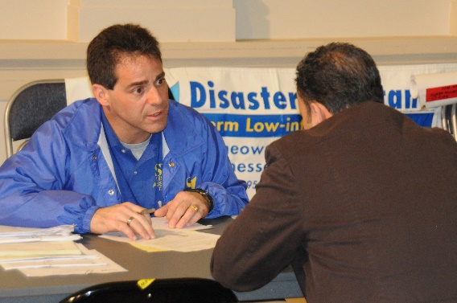
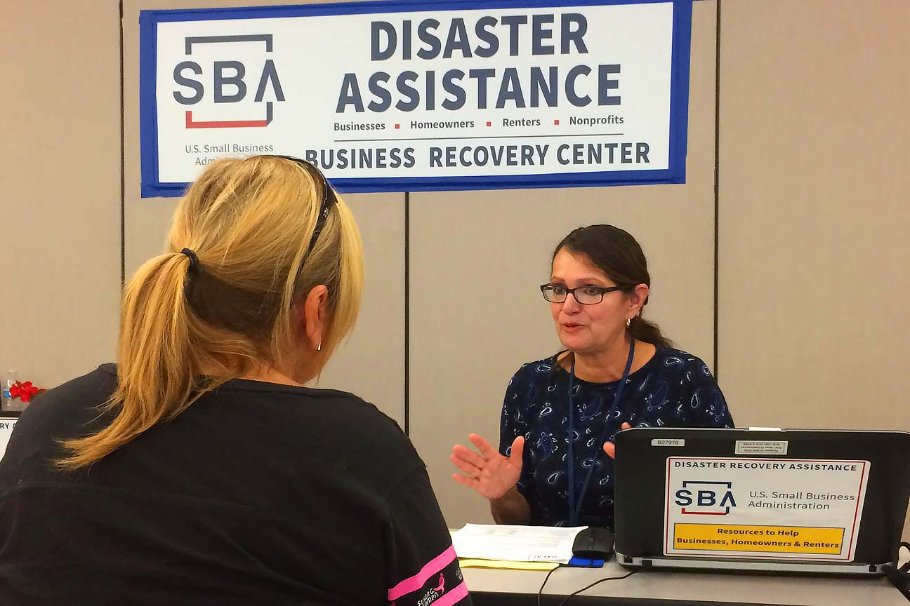
Why apply for an SBA Disaster Loan?
Low interest rates
Cash flow lender
No cost to apply
Flexible terms-up to 30 years
No prepayment penalty
Funds are available even if insurance has not settled
No closing costs
May be eligible for refinancing or relocation
May apply for mitigation funds
First payment deferred
Physical loans over $25,000 require collateral.
Economic injury loans over $25,000 require collateral.
Up to $50,000 unsecured disaster business loans-combined physical and economic injury loan funds.
SBA will not decline a loan for lack of collateral but requires collateral if it’s available.
Federal/State assistance may stop
Loan can be modified
No obligation to take the loan if approved
May be eligible for referral to grant program
10
SBA.gov/Disaster | 1-800-659-2955 | (TTY) 1-800-877-8339

Slide 11
How To Apply | Get Help
Register with FEMA at DisasterAssistance.gov, via the FEMA mobile app or by calling the FEMA toll-free helpline at 800-621-3362 (TTY 800-462-7585).
Apply with SBA at SBA.gov/Disaster; loan applications may also be obtained by contacting our Disaster Recovery Center.
SBA Disaster Recovery Center (DRC)
Open: Monday – Sunday (7 days/week)
Hours: 8 a.m. – 7 p.m. Eastern Time
DRC/ Queens College
152-45 Melbourne Avenue
Queens, NY 11367
Phone: 800-659-2955 (TTY 800-877-8339)
Filing Deadlines:
Physical Property Damage Applications: November 4, 2021
Economic Injury (Working Capital): June 6, 2022
11

Slide 12
Q&A Session
FEMA: DisasterAssistance.gov | 1-800-621-3362 | (TTY ) 1-800-462-7585
SBA: SBA.gov/Disaster | 1-800-659-2955 | (TTY) 1-800-877-8339
Ready.gov/Business | Ready.gov/Plan | FloodSmart.gov
12

